Slide 1
Formula One 2025 Season
How did drivers and constructors progress throughout the season?
Notes:
Opening slide- showing my overarching aim

Slide 2
Formula One 2025 Season - Introduction
In one F1 season there can be a lot of developments with cars, drivers and teams
This can be due to factors like car development and ‘rookies’ getting more confidence
However, some cars are just naturally stronger at different tracks which is not in a ‘linear’ order
To analyse these, a wider analysis can be done, looking at the season as a whole as opposed to one or a few tracks of data
Notes:
Intro- the f1 season can be never be too predictable. The development of the car and the team occur not just prior to the season, but also during the season alongside the races.
My aim was to have a wide analysis of the season for each team and driver.
In some circumstances, linear improvements could be viewed - like a new driver gaining confidence. However, it can be generally non-linear, with certain cars and drivers performing better or worse at different tracks

Slide 3
The Dataset
The initial focus was the qualifying for both sprint and grand prix races, and then the race results
The qualifying results were merged with their respective race results
The two datasets both contained ‘core details’ of the race weekend: the track, driver, their qualifying position and lap times, then their race position and lap times and fastest lap time
This required an initial clean and merge of datasets, dropping any duplicates ( e.g track, driver number).
Further cleans - duplicates of same teams because of differences in capitalisation of letters, renaming column names for neatness
Notes:
Dataset - i chose to just focus on grand prix results post merging each into qualifying and race - this was because I had felt the data was not lacking without the sprint results.
Cleaning and merging of the datasets - multiple ‘rounds’ due to observing small errors in the data set throughout my analysis

Slide 4
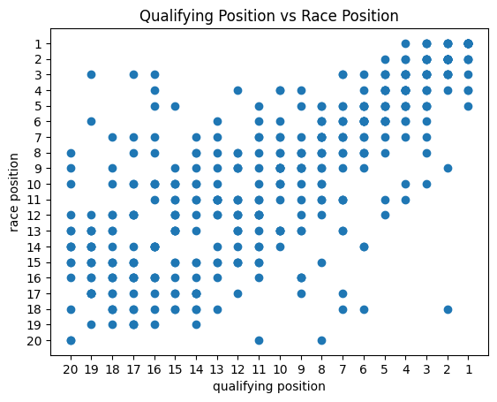

Correlation between qualifying position and race position
Simple Scatter Plot
Polyfit trend fit
Comments:
Generally, an okay plot, it acted as a starter for me when first looking at the data
Positive trend - finish higher than qualify
However, a lot of outliers
Cannot act as a prediction for a race finish
Does not consider specific drivers, tracks or teams - very general
Not very analytical
1
Opens up thoughts of suitability of certain plots, explored later on
Notes:
First plot was just to look at the correlation between qualifying and race result - with a classified finish. I had assumed this would be a bit messy, and not showing much- which it did , a positive trend can be seen with the trend line,but overall the plot cannot act as a prediction and isnt very analytical. Began the questions of suitability of certain plots, which i considered throughout.

Slide 5
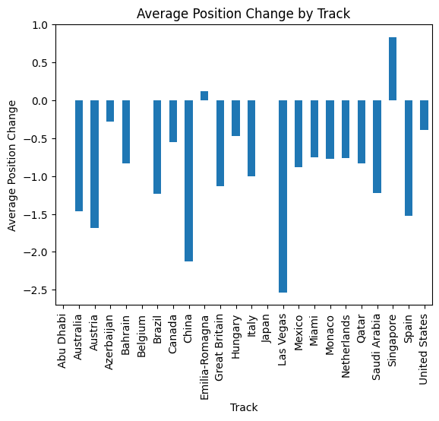
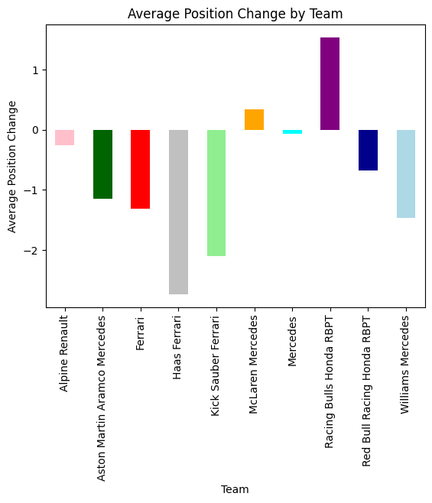
Race and Qualifying Position Changes
2
Looking at features by team allows for analysis of team consistencies
Looking how position changes per track - to see the average a little more detail
+1 is losing a position (e.g 3rd to 4th) , with -1 being gaining a position (4th to 3rd)
Notes:
Changes per track - shows the scatter plot in a more logistical way - however has not got enough detail to be a fantastic plot.
Change per team - this allows analysis of how teams perform after qualifying - their race vs qualifying approach - who is just faster and who has a better strategy for the race. E.g McLaren lost a position from qualifying - generally was the fastest car this season, so the drivers racing and/or strategy lost them positions in the race. Haas and Kick Sauber - midfield cars, but their racing meant they gained positions and even points

Slide 6
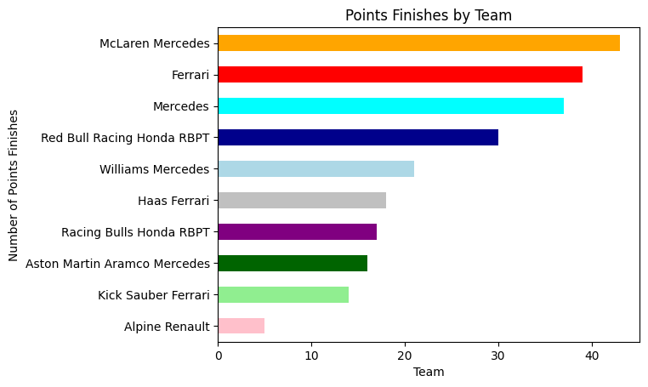
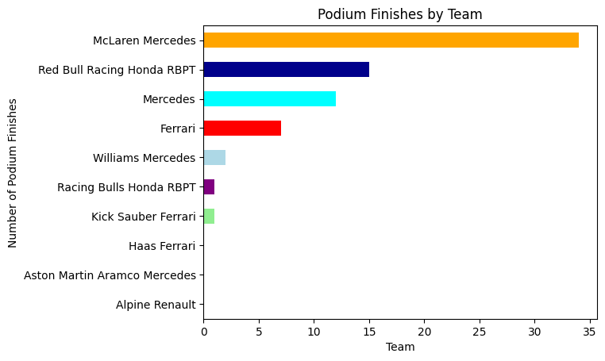
Team Analysis - Points and Podium Finishes
3
This is done by the number of points finishes (top 10) as opposed to the amount of points - as there are 24 races, 48 is the maximum points finishes available for two drivers
Likewise - maximum of 48 podiums
Notes:
Observing what teams were getting the points, this doesnt factor the amount of points gained from the grand prix, but i wanted to focus on consistency. This is further seen by the podium finishes, where even less teams have have them,, with a handful being only 1 or 2. For example, Ferrari - they scored points in most races (19/24 races) but not many podiums, showing a consistent point scoring team, but not a high performing one this season

Slide 7
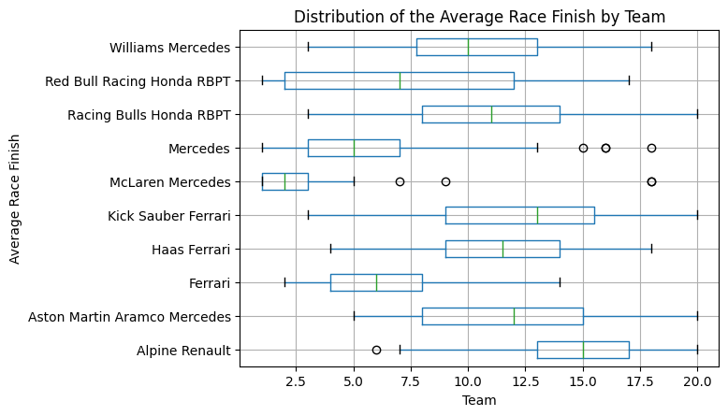
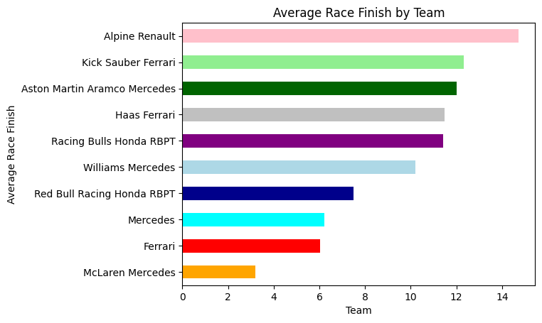
Team Finishes Distribution
4
Whilst this shows generally the best performing teams, it does not give details and can be heavily skewed by a couple of unusually bad or good finishes
Distribution shows the consistency of the team - smaller distributions indicate most of the finishes being in a smaller range (IQR) , indicating any outliers which may have skewed results in a simple bar chart
Mclaren had the smallest IQR, with a couple of extreme outliers
Red Bull had the largest IQR; a lack of consistency across the team
Kick Sauber, Racing Bulls and Red Bull had the largest overall range
Alpine seems to be the lowest performing team with median and IQR
Notes:
Average race finish - to zoom into the points finishes and their consistency - average race position - in an average race who finishes where? The bar plot is more susceptible to extreme results - to improve this box and whisker plot - shows the IQR and the overall range with outliers. Shows the most consistent teams, who finishes in a similar position most of the time.

Slide 8
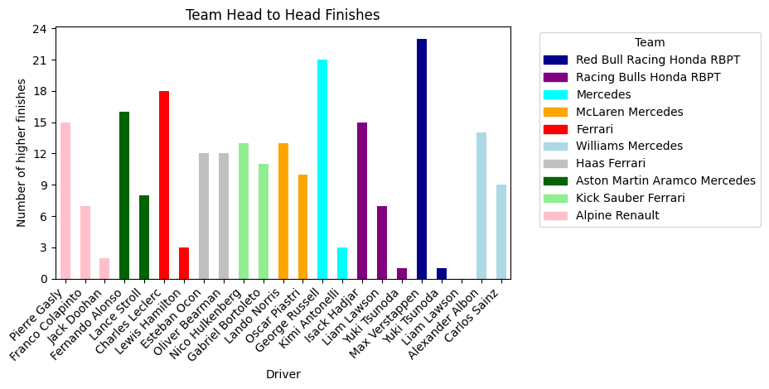
Team Head to Head
5
Simple bar chart to show team ‘Head to Head Battles’
Organised into team and team colours
Red Bull , Ferrari and Mercedes show a clear dominance of Verstappen, Leclerc and Russell respectively
Whereas Haas, Kick Sauber and McLaren are reasonably even, with no particular ‘dominant’ driver
Notes:
head to head battle bar chart. Who was the better driver on the team this season? Some have clear winners, with varying level of extremes - albon is the winner at williams but it is 14:10 , so not as extreme as 23:1at redbull. Some are abit more 50;50, like at haas, mclaren and kicksauber.

Slide 9
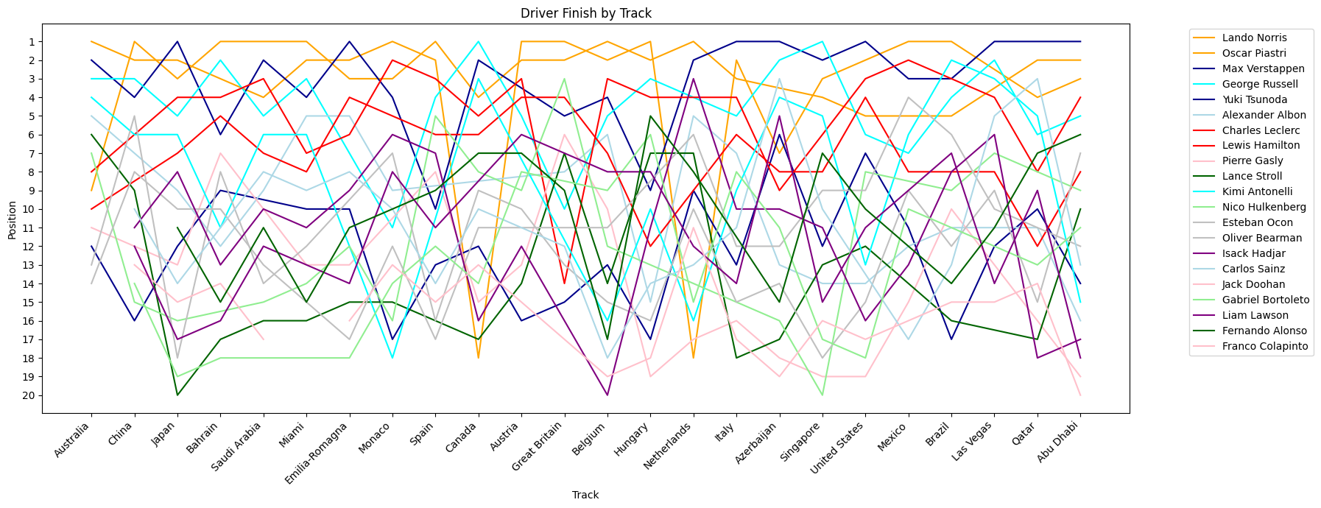
Driver Plots - Evaluating suitability
Notes:
UNSUITABLE PLOT - shows the messiness of plotting 21 drivers

Slide 10
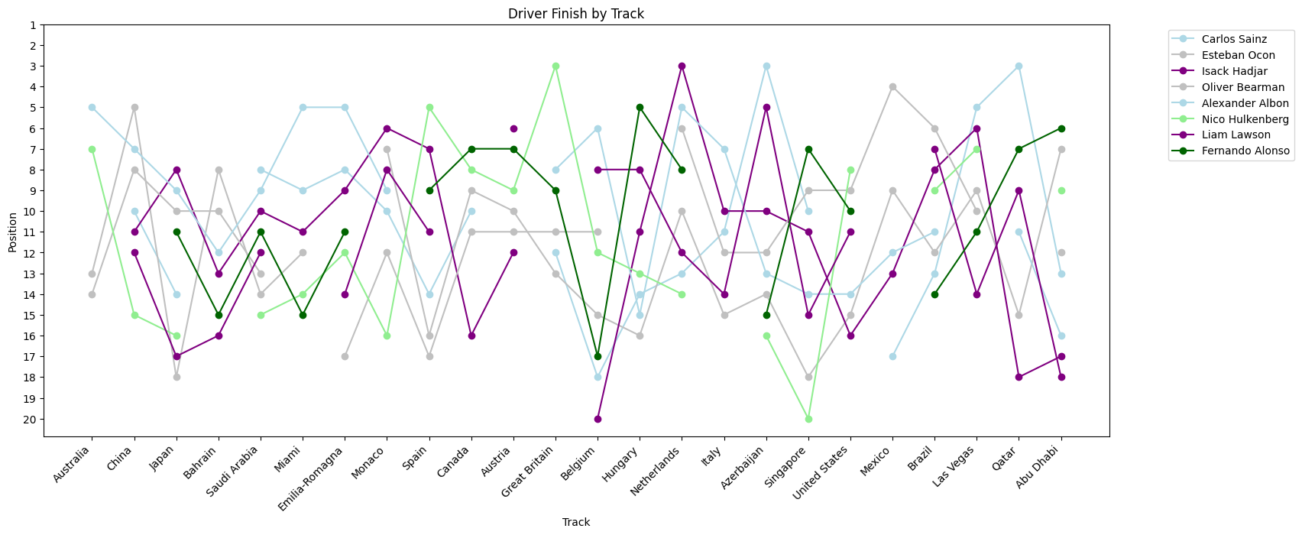
Midfield Driver Plots - evaluating suitability
6
Even with team colours, it is very messy - there are 21 drivers with data this season.
This is not a suitable plot to view or analyse, as the messy plot lacks proper information
Narrowing it down to 10 drivers, choosing positions 8th-15th in WDC for ‘midfield’ to consider how the distribution varies for these drivers
Even with half the data, it is still messy at certain points, with gaps for not finishing
Likewise with average team finishes - a distribution is better
Notes:
When considering individual drivers , it is better to focus on less, no more than 10, especially when looking at every race. This shows my definition of midfield, it is still a bit messy, as they all finish consistently within a certain range of positions - the difference in points between 8th and 15th was 35 points, which includes sprint races, so overall about 1 point per race difference between 8th and 15th - so I expected to see the results a bit more clustered. This would be a good plot if comparing two drivers on a team, or fighting for title (Verstappen, Piastri, Norris) for example

Slide 11
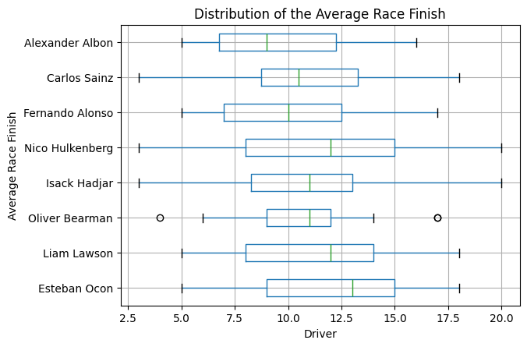
Midfield Driver Plots
This more clearly shows the consistency of the midfield
This can also be further analysed by looking at the medians , it would be expected that it would be in standing order, but can see that is is not
This could be due to unusually good finishes, such as Hulkenberg’s podium and also retirements/ unclassified finishes
Notes:
To visualise the midfield more clearly, box plot is good for analysing their consistency and theory median race position. It is interesting that the median is not in the order of the standings - highlights the range of finishes - something that couldnt be seen on a bar chart or line graph.

Slide 12
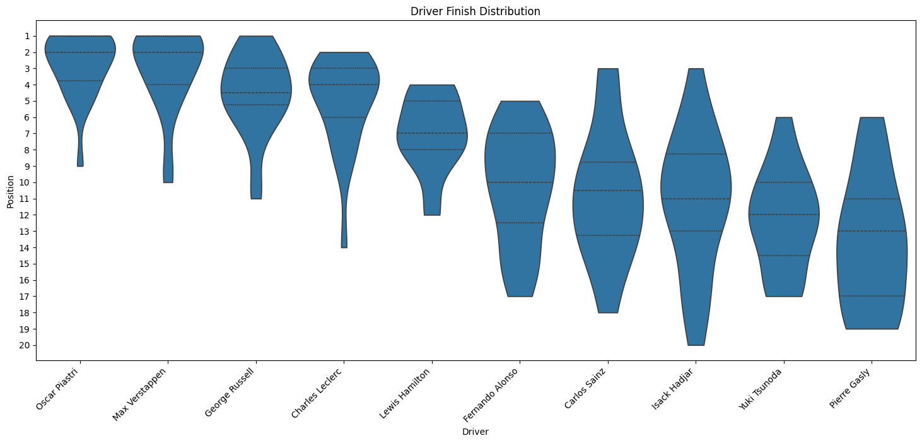
Driver Distribution
7
Another way to analyse driver consistency is using a violin plot, showing the density of each position they finish in
PIA and VER show a triangular density - most dense in the higher positions with possibly 1 or 2 lower finishes
SAI , GAS, ALO and HAD show the most rectangular distributions - larger range of positions
Notes:
Violin plot for distribution - analyse 10 random drivers - higher density is where they mostly finish, a smaller shape shows a lower range and it being rectangular would show no particular position was the most common. Triangular shows higher number of finishes in one area, slowly ‘trickling’ down to their less common personal ‘outlier’ positions

Slide 13
Challenges Faced
Cleaning the data - focussed on classified finishes (P1-P20) , errors in team names other details
Issues with merging sprint races and grand prix races successfully/ neatly
Messy plots - 21 drivers and 10 teams initially made it difficult to find ‘clean’ plots that were not just ‘dots’ and messy lines
Getting used to using GitHub and Git repositories.
I did not think it was necessary to use multiple branches
Other general small issues with codes with easy fixes (code errors etc.)
Choosing which plots are the best to analyse and evaluate
Finalising what I want to show with my dataset
Notes:
As above - overall I was able to have my data analysis all come under the aim of ‘driver and team progression and consistency throughout the F1 2025 season’

